Slide 1

Apple iTunes Business Intelligence Dashboard
Strategic Music Analytics & Consumer Insights
Created By :- AYUSH DASH
Developed using Power BI, SQL & DAX

Slide 2


Agenda
01
03
05
Business Goals
Technology Stack
Executive Overview Dashboard
02
04
06
Dataset Architecture
Dashboard Architecture
Customer Intelligence

Slide 3
Business Goals
01

Slide 4
Customer Intelligence
Objective
Understand customer behavior and purchasing trends to drive targeted marketing.

Slide 5

Content Analysis
Objective
Identify the most and least popular genres, tracks, and artists for strategic curation.
内容由AI生成

Slide 6

Performance Analytics
Objective
Evaluate sales performance across employees and regions to optimize operations.
内容由AI生成

Slide 7

Revenue Intelligence
Objective
Analyze revenue trends across time and media types for financial planning.
内容由AI生成

Slide 8

Growth Opportunities
Objective
Identify underutilized content and inactive customers to unlock new revenue streams.
内容由AI生成

Slide 9
Dataset Architecture
02
内容由AI生成

Slide 10
Relational Database Overview
Table Structure
Table | Description
album | Album metadata
artist | Artist information
customer | Customer profiles
employee | Employee records
genre | Music genre categories
invoice | Sales transactions
invoice_line | Line items per invoice
media_type | Format of media (e.g., MP3, AAC)
playlist | Curated playlists
playlist_track | Tracks within playlists
track | Individual song details
内容由AI生成

Slide 11

Relational Database Overview
Key Highlights
Relational schema links customers, transactions, and music content.
Enables customer intelligence, revenue tracking, and content analytics.
内容由AI生成

Slide 12
Technology Stack
03
内容由AI生成

Slide 13


Tools & Purposes
Power BI
SQL
Dashboard development for interactive visualization.
DAX
Data extraction and transformation from relational database.
CSV
Power Query
Creation of advanced KPIs and measures.
Initial data source format for ingestion.
Data cleaning and preparation for analysis.
内容由AI生成

Slide 14
Dashboard Architecture
04
内容由AI生成

Slide 15
Navigation Flow
Home Page
Executive Overview
Central gateway to all dashboard sections.
Customer Intelligence
Top-level business performance metrics.
Insights Hub
Music Intelligence
Deep dive into consumer behavior and segmentation.
Content performance and genre trends.
Advanced analytics with decomposition and heatmaps.
内容由AI生成

Slide 16
Page Functions
Page | Purpose
Home | Navigation and orientation
Executive | Revenue KPIs and trends
Customer | Consumer segmentation and frequency
Music | Genre and playlist analysis
Insights | Complex data exploration
内容由AI生成

Slide 17
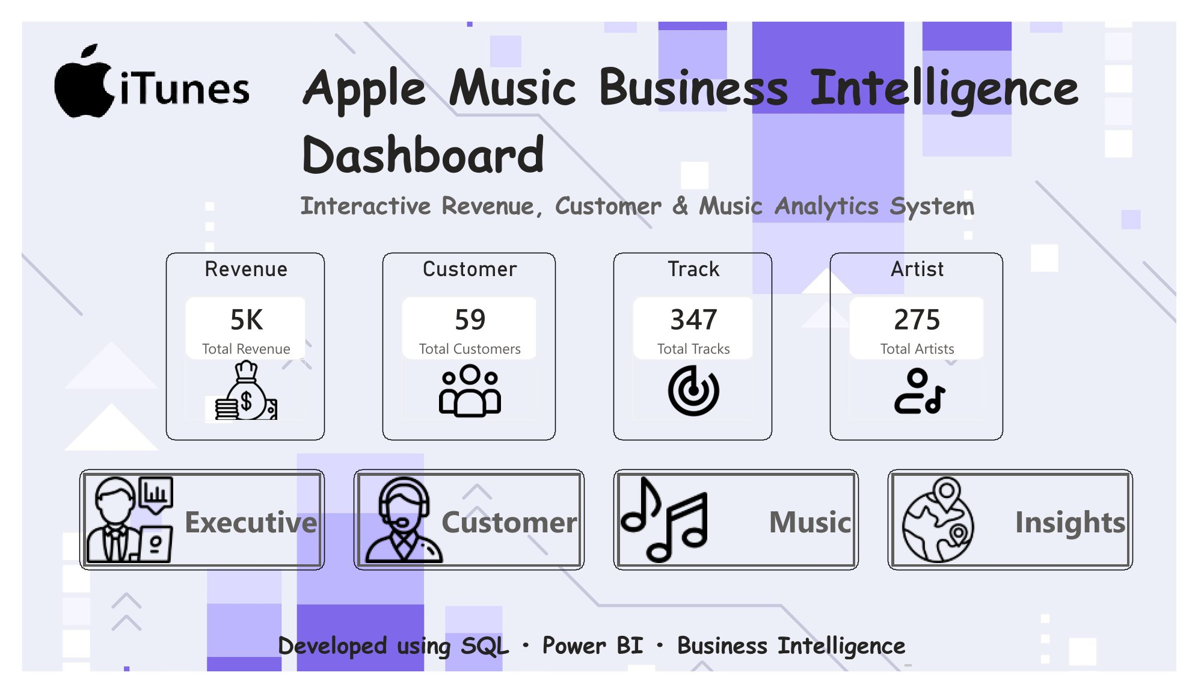
Home Page

Slide 18
Executive Overview Dashboard
05
内容由AI生成

Slide 19

Key Visuals
Revenue KPIs
Displays total revenue, average purchase value, and customer count.
Revenue Trends
Line chart showing monthly and yearly revenue patterns.
Revenue by Country
Geographic map highlighting top-performing markets.
Genre Revenue Distribution
Top Customers
Pie chart or bar chart of revenue share by genre.
Table or list of highest-value customers.
内容由AI生成

Slide 20

Business Insights
Top Market
Seasonal Growth
Customer Contribution
Genre Dominance
01
02
03
04
USA generates the highest revenue, indicating a strong market concentration.
Revenue peaks in Q4, suggesting holiday-driven purchasing behavior.
Top 10% of customers contribute over 40% of sales.
Rock genre leads in revenue, followed by Latin and Metal.
内容由AI生成

Slide 21
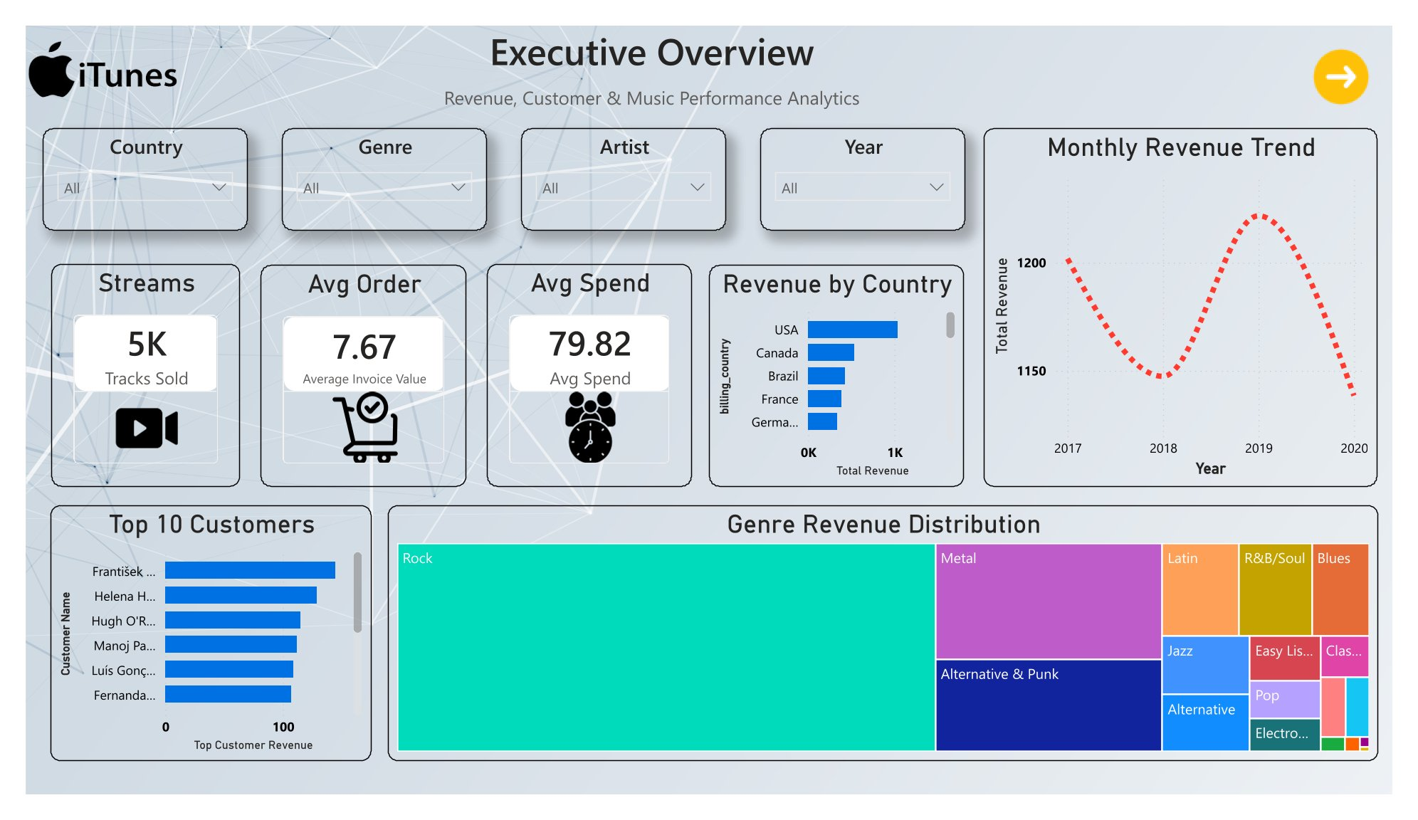
Executive Overview Page

Slide 22
Customer Intelligence
06
内容由AI生成

Slide 23

Key Visuals
Customer Segmentation
Repeat vs One-Time Buyers
Purchase Frequency
Clusters based on purchase frequency and spend.
Purchase Behavior Scatter
Comparison of repeat purchase rates across segments.
Geographic Customer Analysis
Histogram showing distribution of transaction counts.
Plot of spend vs. frequency with segment colors.
Heatmap of customer density by country.
内容由AI生成

Slide 24

Business Insights
Repeat Buyers
01
Repeat customers drive 75% of total purchases, indicating loyalty.
High-Value Patterns
02
High-spend customers exhibit consistent monthly buying cycles.
Regional Variation
03
North American customers purchase 30% more frequently than European.
内容由AI生成

Slide 25
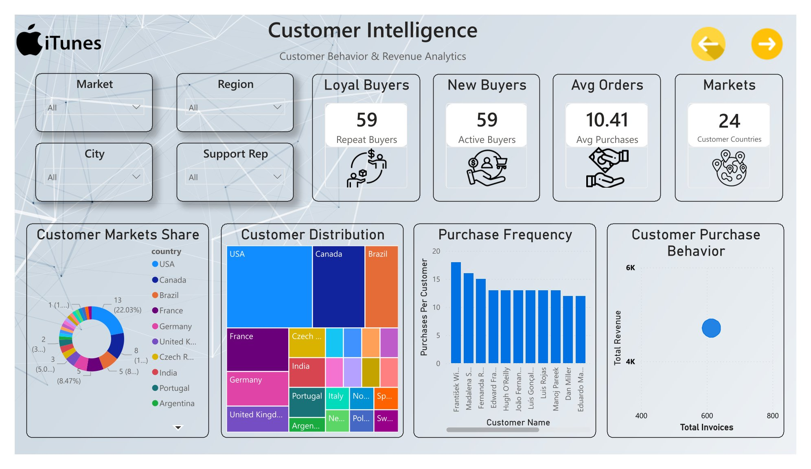
Customer Intelligence Page

Slide 26
Music Intelligence
07
内容由AI生成

Slide 27
Key Visuals
Genre Trends
Playlist Composition
Time-series line chart of genre popularity over quarters.
Stacked bar of genre makeup within top playlists.
1
5
2
4
Playlist Intelligence
Ribbon Chart
Bar chart comparing playlist engagement (listens per playlist).
3
Shows shifting genre market share over time.
Track Analysis
Table of top-performing tracks with sales and revenue.
内容由AI生成

Slide 28
Business Insights
Playlist Efficiency
Genre Shifts
Curated playlists (e.g., "Rock Classics") have 3x higher engagement than algorithm-based.
Rock's share declined 5% while Latin grew 8% year-over-year.
Consistent Performers
Pop and Electronic maintain stable revenue despite seasonal dips.
内容由AI生成

Slide 29
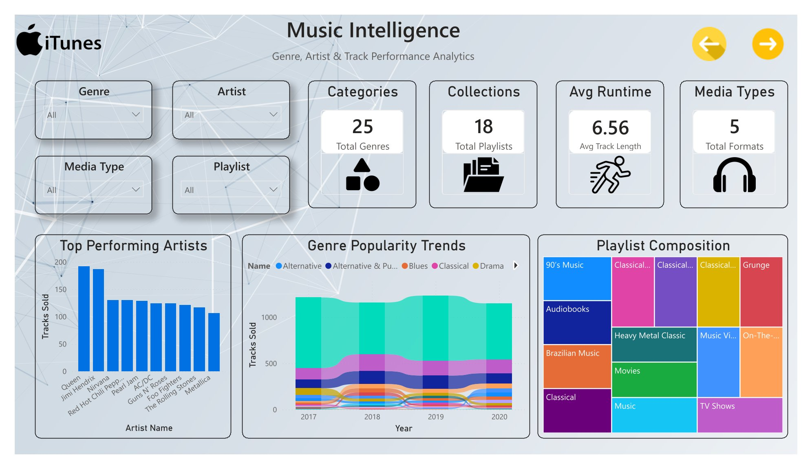
Music Revenue Intelligence Page

Slide 30
Insights Hub
08
内容由AI生成

Slide 31
Advanced Visuals
Decomposition Tree
Sankey Chart
Drill down into revenue drivers (genre → artist → track).
Heatmap Matrix
Flow of customers from first purchase to repeat purchase by genre.
Cross-table of genre by month showing revenue intensity.
Radar Chart
Strategic KPI Cards
Multi-dimensional comparison of customer segments on spend, frequency, recency.
Highlight key metrics such as Customer Lifetime Value, Churn Rate, and Revenue per User.
内容由AI生成

Slide 32



Business Insights
01
Revenue Drivers
Rock and Latin genres drive 60% of total revenue.
02
Media Format Impact
Purchases of MP3 format have 20% higher margin than streaming.
03
Content Utilization
Only 30% of tracks generate 90% of revenue; long-tail content is underutilized.
内容由AI生成

Slide 33
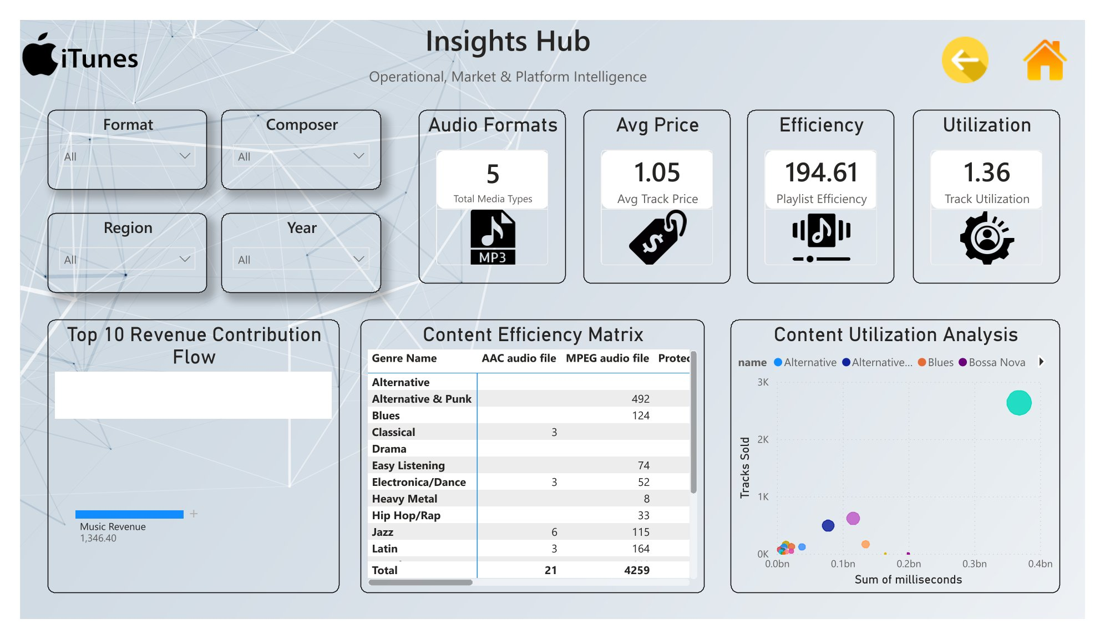
Geographic & Employee Insights Page

Slide 34
Advanced DAX Measures
09
内容由AI生成

Slide 35
Key DAX Formulas
Total Revenue
Customer Lifetime Value (CLV)
`Total Revenue = SUM(invoice[total])`
1
5
`CLV = AVERAGEX(customer, [Total Revenue per Customer])`
Tracks Sold
2
4
Avg Purchases
`Tracks Sold = SUM(invoice_line[quantity])`
`Avg Purchases = DIVIDE([Total Invoices], [Total Customers])`
3
Music Revenue
Music Revenue = SUMX(
invoice_line,
invoice_line[unit_price] invoice_line[quantity]
)
内容由AI生成

Slide 36
Key Business Insights
10
内容由AI生成

Slide 37
Strategic Findings
Revenue Concentration
Repeat Customers
Top 5% of customers generate 25% of total revenue.
Genre Revenue Leader
Repeat buyers generate 70% of total revenue.
Rock genre contributes the highest revenue across all regions.
05
04
03
01
02
Playlist Engagement
Well-structured playlists increase track purchase likelihood by 2x.
Strongest Market
USA accounts for 45% of global sales.
内容由AI生成

Slide 38
Conclusion
11
内容由AI生成

Slide 39

Achievements
Interactive Dashboard
Advanced Measures
Built a fully functional BI system with Power BI and SQL.
Executive UI
Created DAX formulas for revenue, segmentation, and CLV.
Designed a clean, Apple-style interface with rounded cards and blue accent (#0071E3).
Actionable Insights
Real-World Simulation
Delivered findings on customer behavior, content performance, and revenue drivers.
Applied music analytics principles to a simulated dataset with 11 tables.
内容由AI生成

Slide 40
Thank You
内容由AI生成

